Slide 1
Zero-Shot Transfer Learning for Event Extraction
Haijun Zhang
2018/10/10

Slide 2
Outline
Introduction
Approach
Experiments
Conclusion

Slide 3
Preliminary: Zero-Shot learning
Zero-Shot leaning :
A type of Transfer learning
Predicting unseen classes with no(zero) additional training examples.
Notes:
Transfer Learning is the reuse of a pre-trained model on a new problem

Slide 4
Preliminary: Event Extraction
What is event?
Key elements: event trigger and event argument
An Event is a specific occurrence involving participants.
What’s event extraction?
Identify event triggers and arguments in unstructured text, and then assign an event type to each trigger and a semantic role to each argument
What’s event schema?
Types of triggers and types of the arguments and the relations among these types

Slide 5
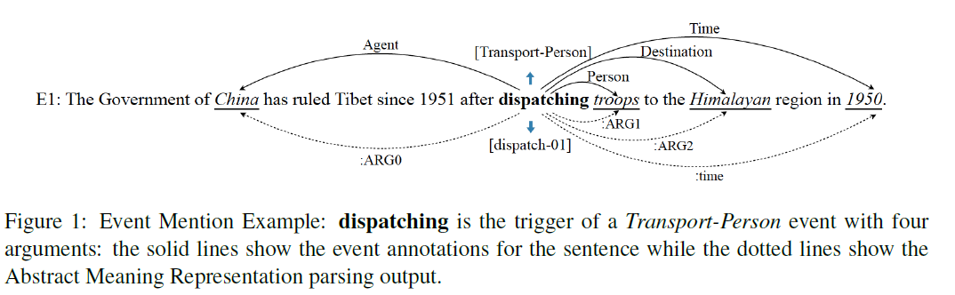
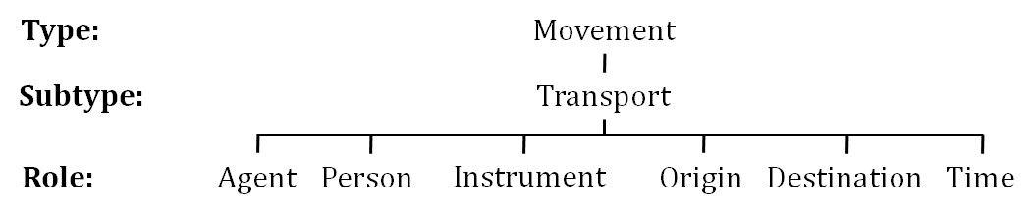
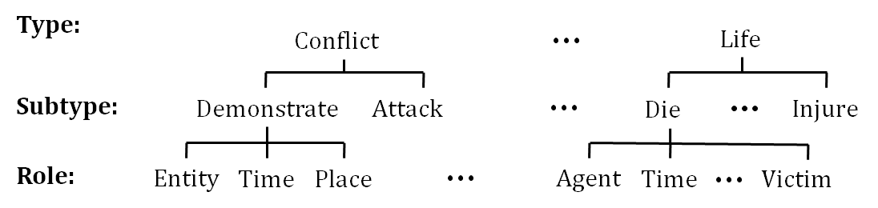
Example

Slide 6
Problem to Tackle
Cannot be applied to new event types without extra annotation effort.

Slide 7
Outline
Introduction
Approach
Experiments
Conclusion

Slide 8
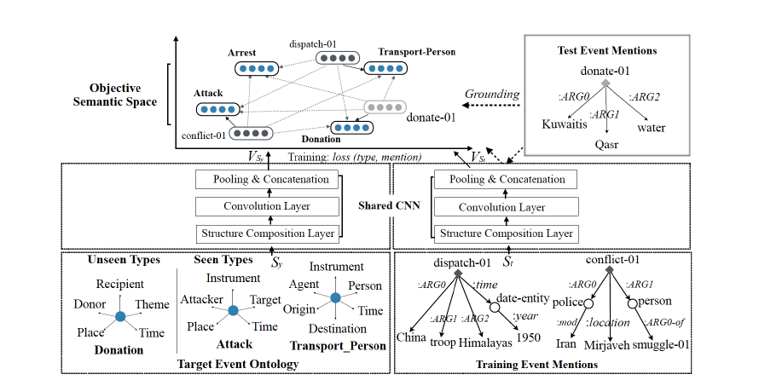
Architecture Overview

Slide 9
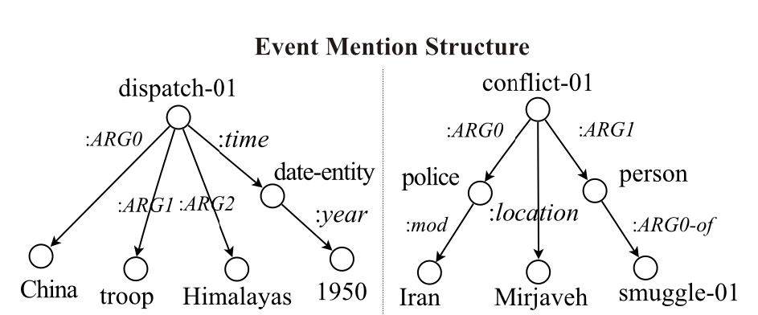
Trigger and Argument Identification
E1. The Government of China has ruled Tibet since 1951 after dispatching troops to the Himalayan region in 1950.
E2. Iranian state television stated that the conflict between the Iranian police and the drug smugglers took place near the town of mirjaveh.

Slide 10
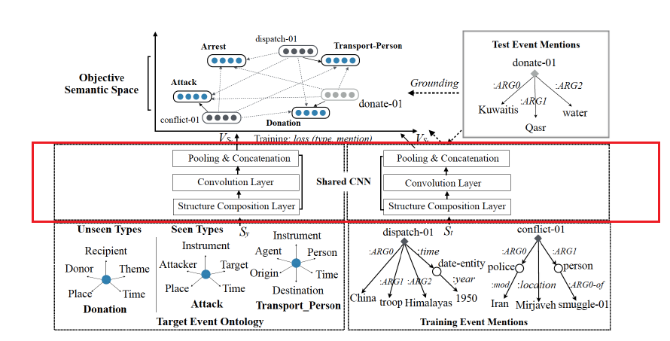
Trigger and Type Structure Composition

Slide 11
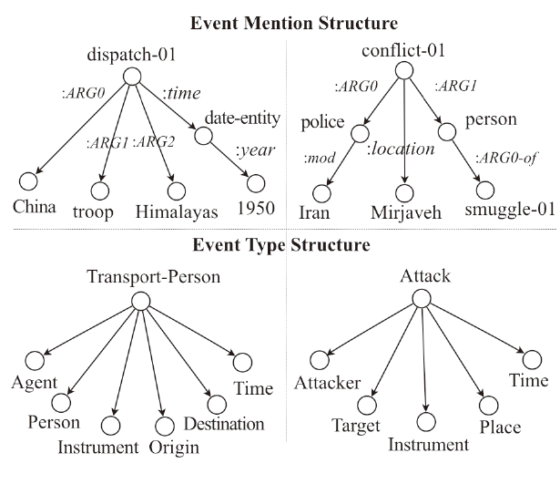
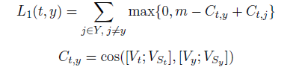
Trigger and Argument Classification
Trigger Classification for Seen Types
Argument Classification for Seen Types
Decompose path into tuple sequence:
Argument Path(between trigger t and a candidate argument a):
e.g. dispatch-01->:ARG0-> China
Argument Role Path(between type of event t and role of argument):
e.g. Transport-Person->Agent
Do the same as trigger Classification

Slide 12
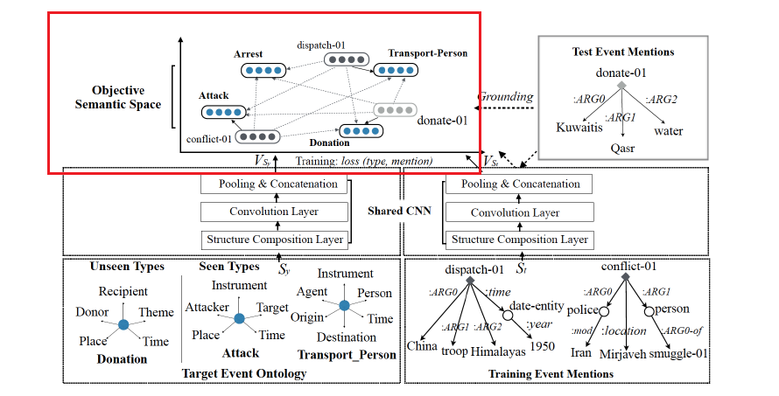

Slide 13

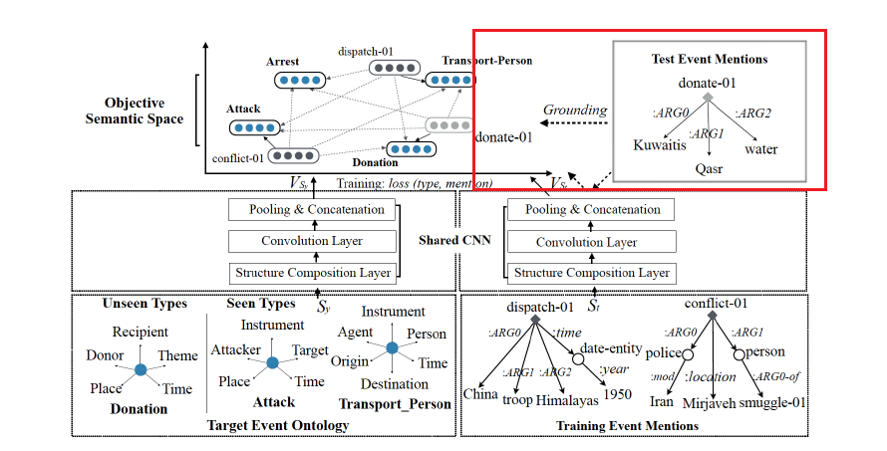
Zero-Shot Classification for Unseen Types

Slide 14
Outline
Introduction
Approach
Experiments
Conclusion

Slide 15
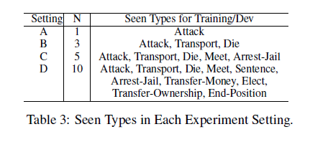
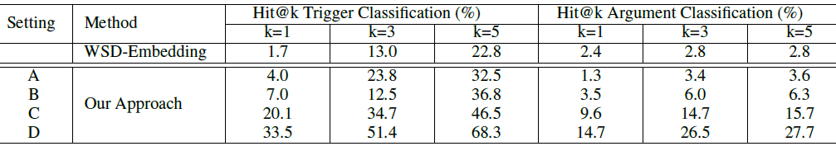
Effectiveness of Structural Representation
ACE data: 8 general types, 33 fine-grained subtypes
Training data: A,B,C,D respectively
Testing data: remaining 23 unseen types
Comparison between Structural Representation (Our Approach) and Word Sense Embedding based Approaches on Hit@K Accuracy (%) for Trigger and Argument Classification.

Slide 16
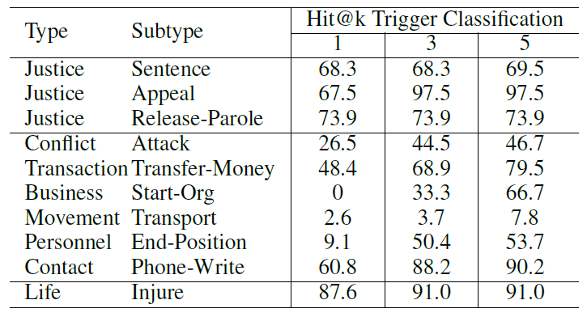
For training our transfer model, we selected 4 subtypes of Justice: Arrest-Jail, Convict, Charge-Indict, Execute.
Then Predict other unseen subtypes

Slide 17
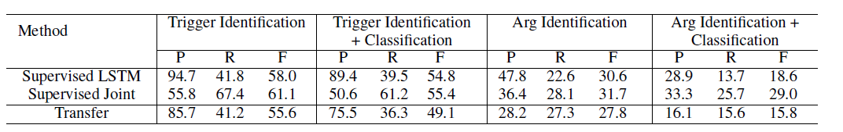
Compared our approach with the following state-of-the-art supervised methods
Event Trigger and Argument Extraction Performance (%) on Unseen ACE Types.
Train data: supervised(entire 33 subtypes), transfer(10 subtypes)
Test data: held-out 150 evaluation sentences in remaining 23 subtypes

Slide 18
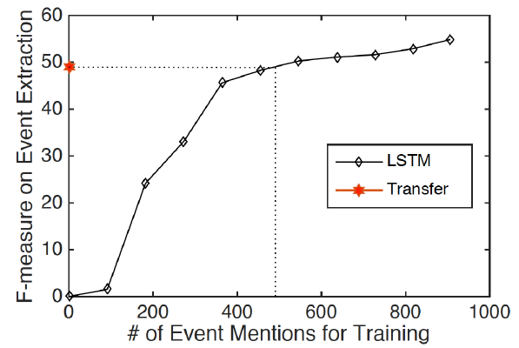
Comparison between Our Approach and Supervised LSTM model on 23 Unseen Event Types.
Train data:
LSTM (23 subtypes)
Transfer(10 subtypes)
Test data:
Held-out data in remaining 23 subtypes
Transfer learning approach
= LSTM trained on 3000
sentences with 500 annotated
event mentions

Slide 19
Conclusion
This transferable neural architecture:
leverages existing human constructed event schemas and manual annotations for a small set of seen types,
and transfers the knowledge from the existing types to the extraction of unseen types,
hence improves the scalability of event extraction as well as to save human effort.

Slide 20
Thank You

